Slide 1


Presentation Title
Month day, year
Your Name
Class Name
Subtitle or catch phrase for the presentation

Slide 2
Trash is waste material that is discarded by humans, usually due to a perceived lack of utility.
It affects human health and causes serious health diseases. Such as- several types of cancer.
The toxic material that pollutes the soil get into the human body directly-
By breathing in polluted dust
By eating fruits and vegetables that have been grown in polluted soil.
We are…
Throwing trash anywhere
Burning trash sometimes.
And What happens Next?
It causes…
Water Pollution
Land and Soil Pollution
Air Pollution
Is there any way to use Trash in a better way?

Slide 3








What If Someone…
Gives us CASH for TRASH.
To whom we can call to collect
the trash by an Mobile App.
Who will use the trashes to
turn them into energy.
It can serve in the society.

Slide 4



Hey,I have some Trash.

Slide 5





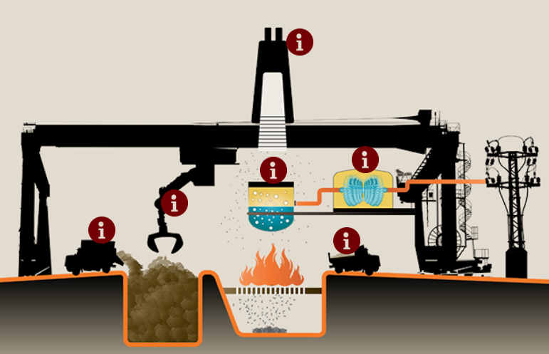
Trash To Energy
Trucks dump trash into
storage bunker.
Crane transfers trash
to incinerator.
Burning the trash boils
water, creating steam.
Steam turns a turbine,
generating electricity.
Ash left over from
burning trash is removed
for recycling and disposal.

Slide 6
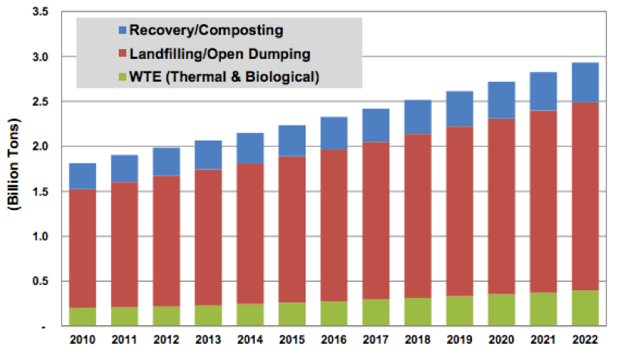
Feasibility Study…
We are planning to setting up a new process by which we can make the best use of waste.
Energy from waste is an environmentally friendly solution, both from a waste management perspective and as an alternative to conventional sources of energy generation.
In world market The market for WTE technologies is projected to reach $29.2 billion by 2022, up from $6.2 billion in 2012.

Slide 7
Economic Value…
Current waste generation in Bangladesh is around 22.4 million tonnes per year and it is projected to reach 47, 064 tonnes per day by 2025.
In world market WTE technologies is projected to reach $29.2 billion by 2022, up from $6.2 billion in 2012.
Build the facility is estimated at Tk 3472 crore where Bangladesh’s largest LNG-based power plant at Payra cost at Tk 22,652 crore.
Operating costs at Tk 182 crore per year.
Export to the grid 0.6 MWh of electricity per ton of waste incinerated, that is, 380 GWh of electricity per year and translate into approximately Tk 289 crore taka revenues per year.

Slide 8

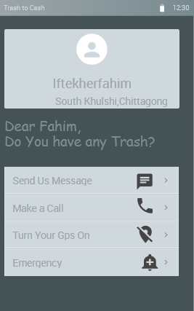
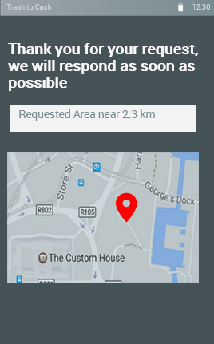
Prototype…

